Slide 1
PERCUSSION INSTRUMENT BINGO
With Ms Sam

Slide 2
HOW TO PLAY
Here are the instructions on how to play Percussion Instrument Bingo.
Print off enough bingo cards for you and your players.
Find items that will work as markers. Things that work well: coins, candies, etc. Anything small that you have a lot of.
Watch Video #1: Intro to Instruments so you can learn about the instruments and their sounds.
Watch Video #2: Play the Game.

Slide 3
PERCUSSION
INSTRUMENTS:
Instruments you hit or scrape!
There are many different percussion instruments. Here were are going to learn about some of them and their sounds.

Slide 4
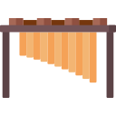
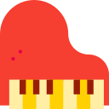
1. Pitched
(Makes a pitch)

Slide 5
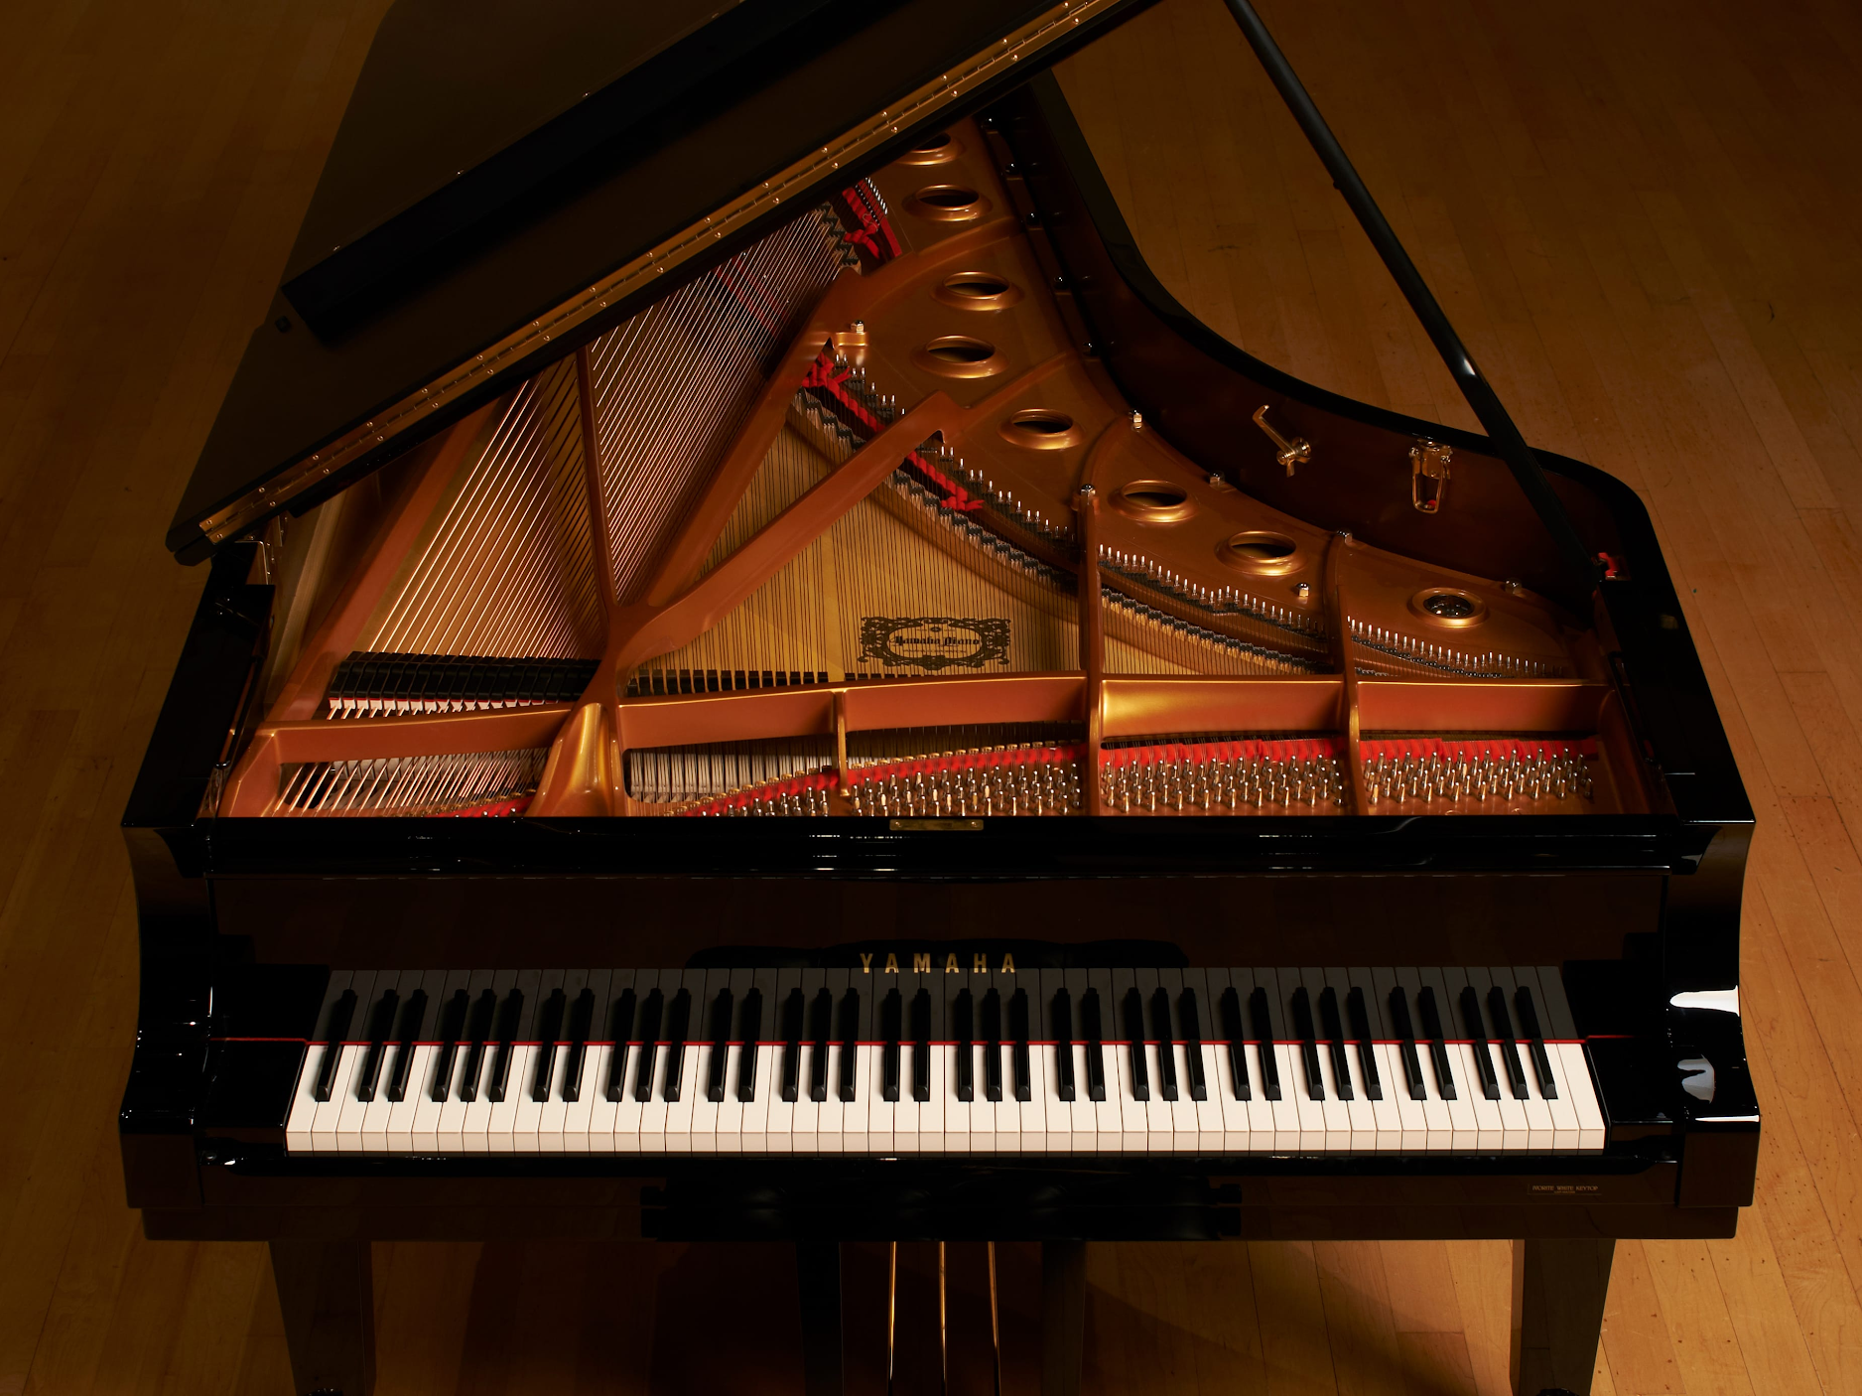
1. Piano/Keyboard
Actually a hybrid: percussion & string
Keys pressed by player
Pedals to sustain notes

Slide 6
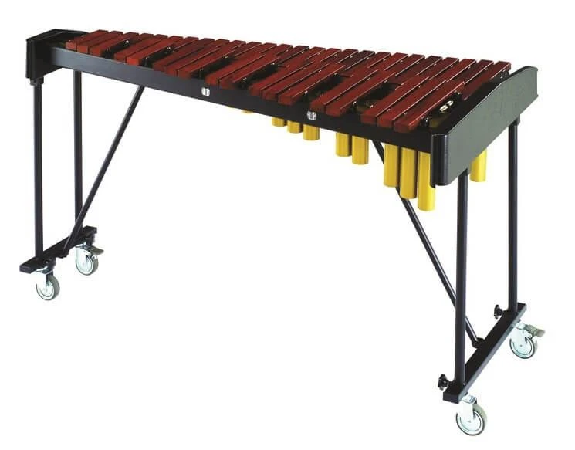
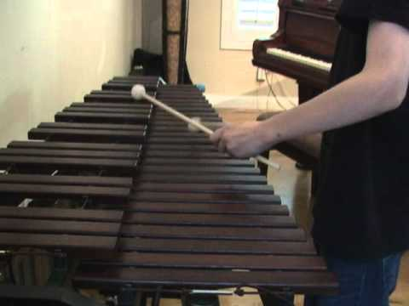
2. Xylophone
Wooden keyboard you hit with mallets
Has resonators (metal tubes) under the bars -

Slide 7
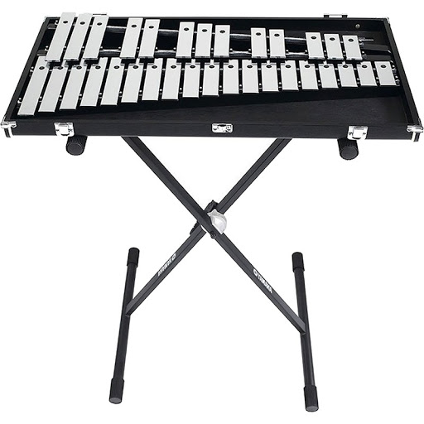
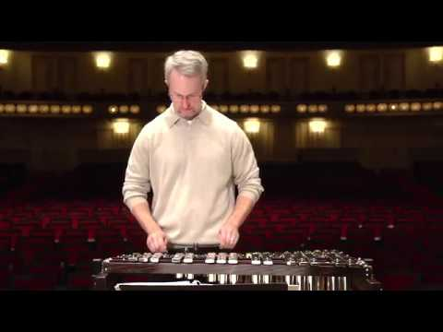
3. Glockenspiel
Similar to xylophone but metal
Some have resonators, some don’t

Slide 8
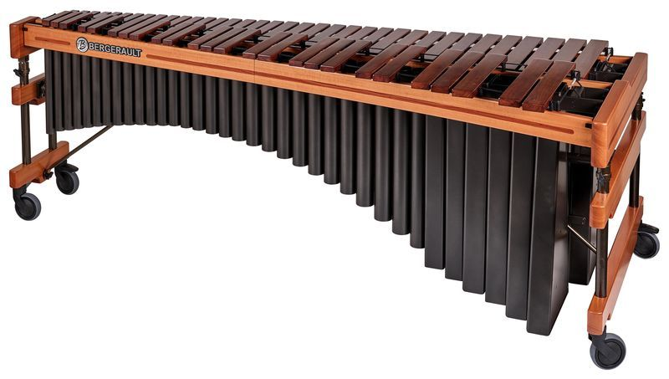
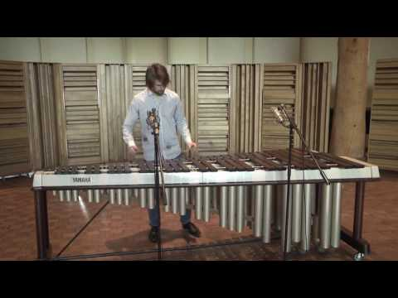
4. Marimba
Similar to xylophone
Bigger, more wooden sound
Longer, larger resonators

Slide 9
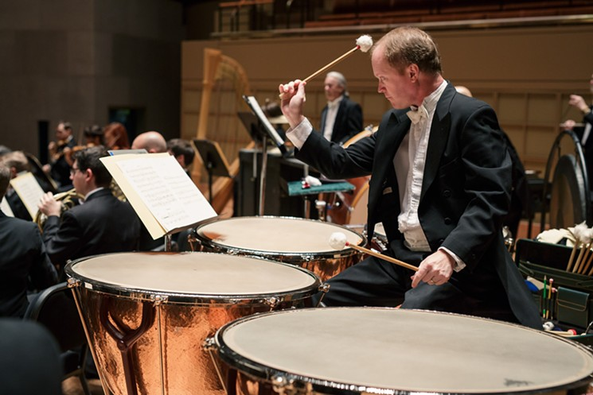
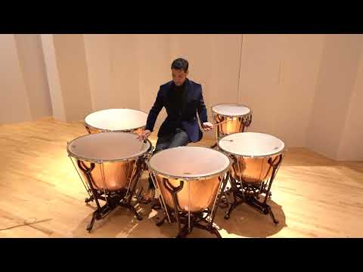
5. Timpani
Large drums which can be tuned with pedal to make a certain pitch
Have one for each note you need
Hit with
large
sticks/
mallets

Slide 10
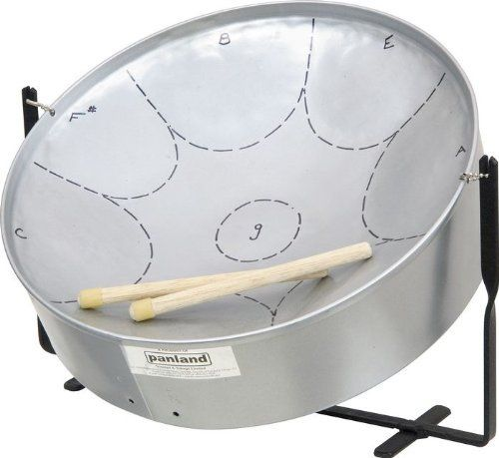
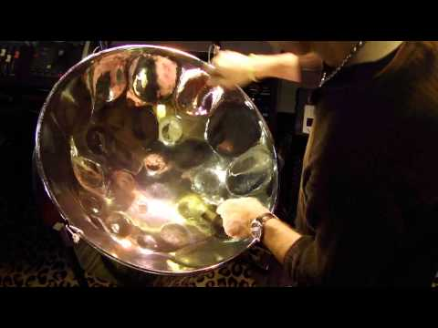
6. Steel Drum
Originally from Trinidad/Tobago
Not actually technically a drum, steel pan
Different parts of it are pitched for
different
notes
Hit with
rubber sticks

Slide 11
2. Unpitched
(Does not make a pitch)

Slide 12
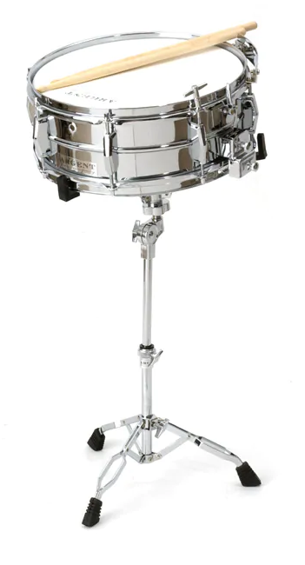
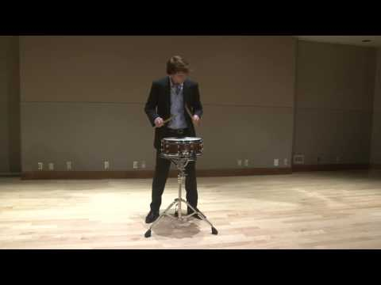
1. Snare drum
Drum with with snares against the bottom head
Snares can be turned on or off
Part of a drum set
Played with sticks

Slide 13
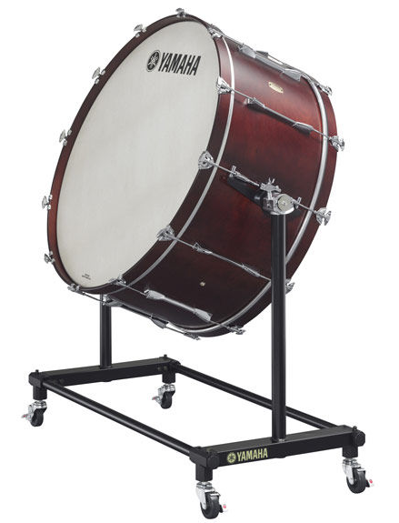
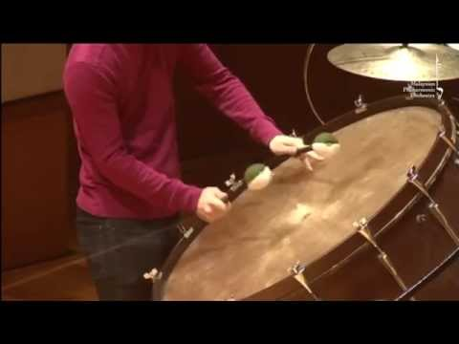
2. Bass Drum
Large drum that makes a low sound
Part of a drumset
Played with a big mallet

Slide 14
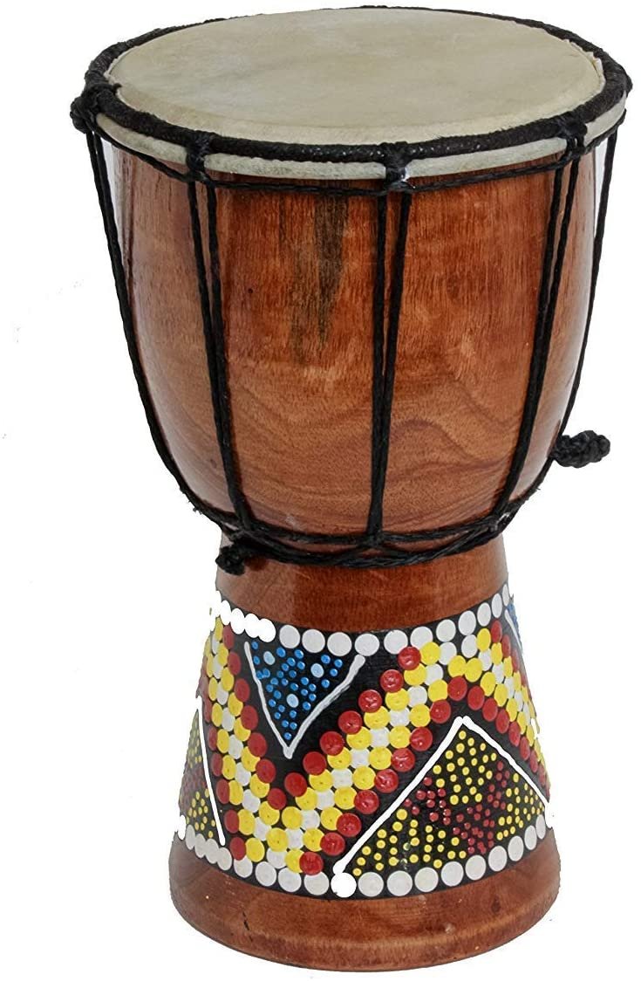
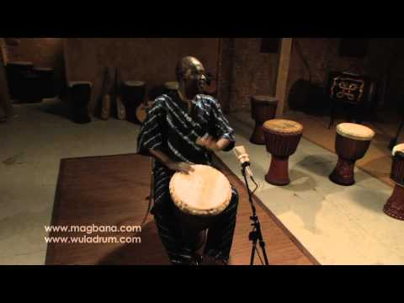
3. Djembe
Hand drum from West Africa
Played by hand
Bottom resonating chamber has to be tilted up so sound can escape

Slide 15
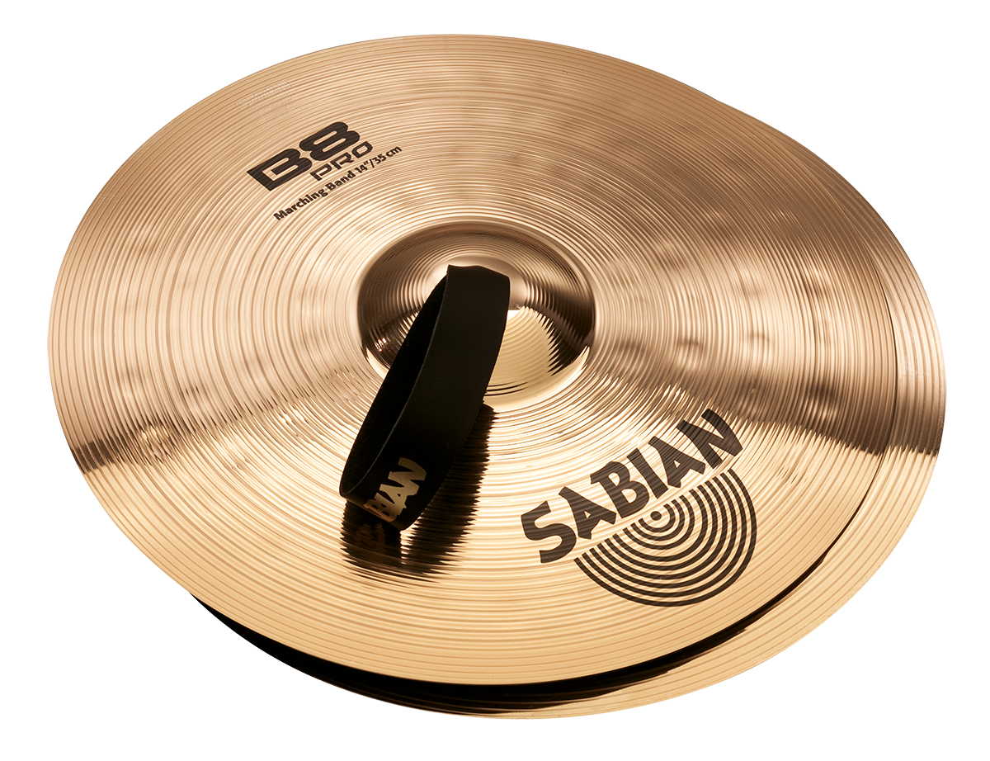
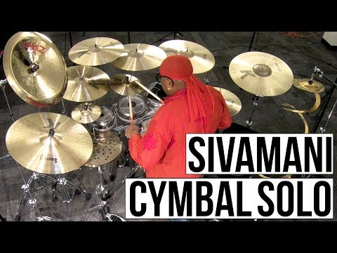
4. Cymbals
Big metal disks
Can be hit (such as suspended symbol), and can be scraped together (crash cymbals)

Slide 16
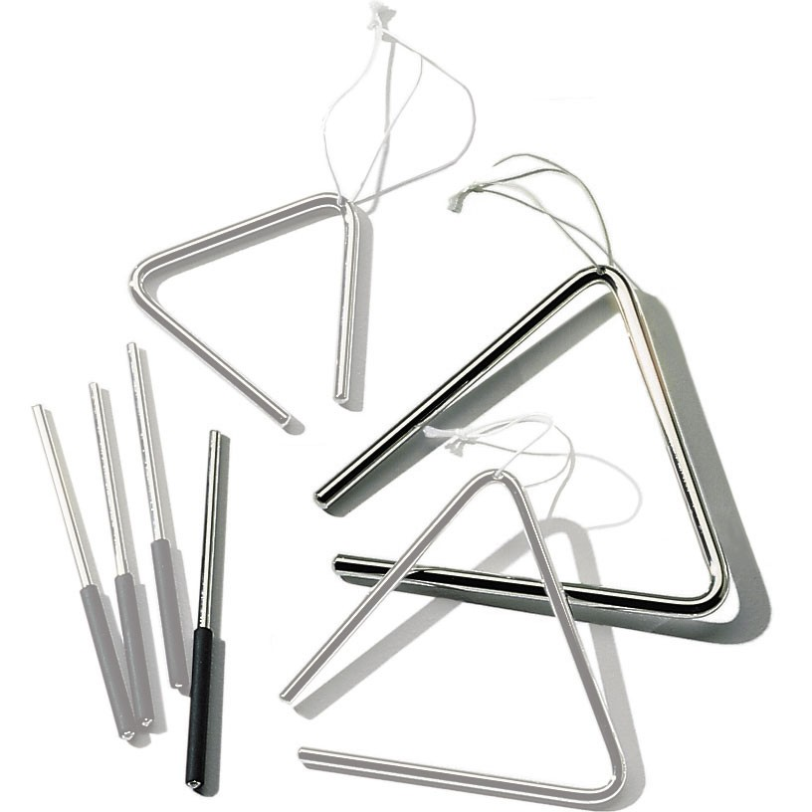
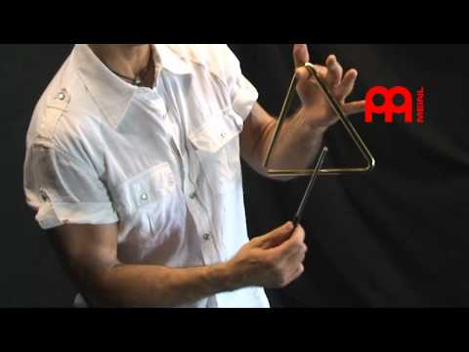
5. Triangle
Metal triangle played by striking with metal stick

Slide 17
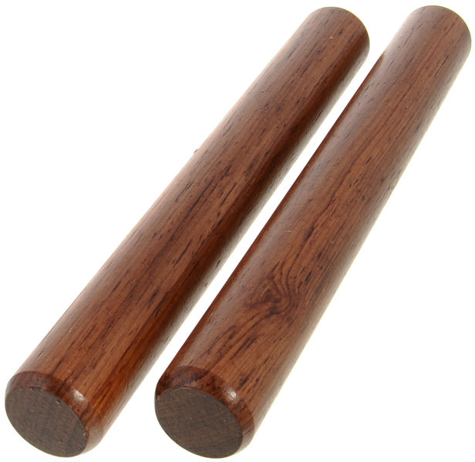
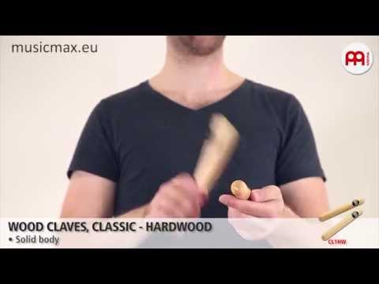
6. Claves
Two dowels of wood that you hit together
You hold one in your palm and use the other to hit
the
top

Slide 18
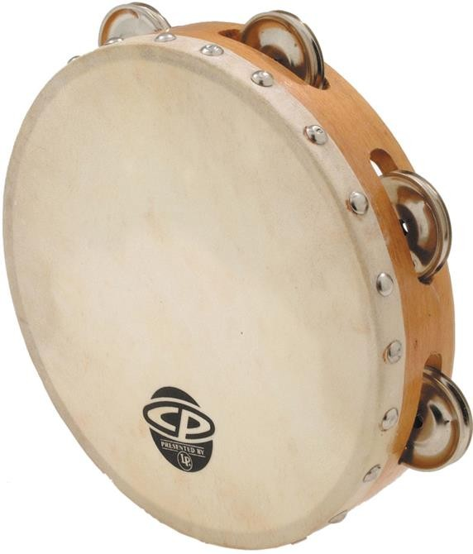
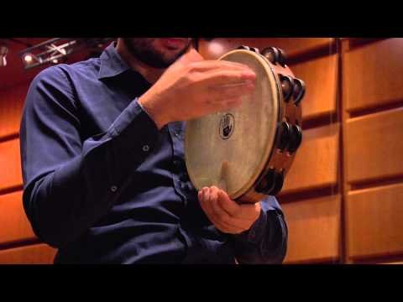
7. Tambourine
A wooden frame with small metal cymbals (zills) around the edge
Some have a drumhead, some don’t
Play by holding
with one hand,
hitting with
other and
shaking

Slide 19
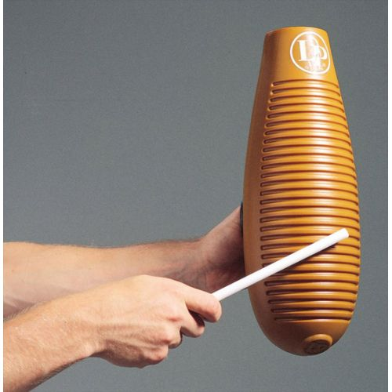
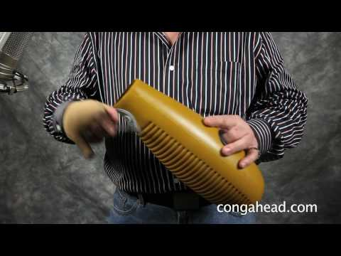
8. Guiro
Latin American instrument
Originally made out of a hollowed out gourd, with notches cut in the side
Played by scraping a stick against the
notches

Slide 20
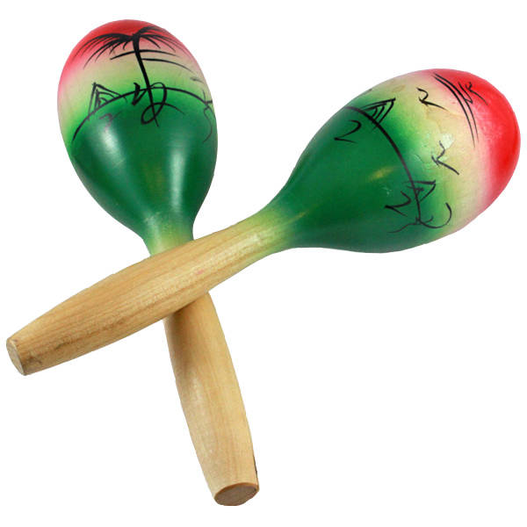
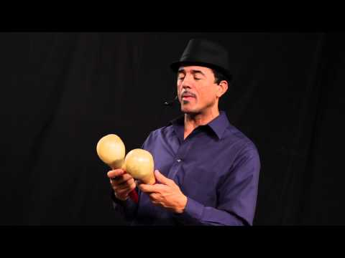
9. Maracas
Very important in Caribbean and Latin music
Rattle that you shake to make sound (filled with small
beads)

Slide 21
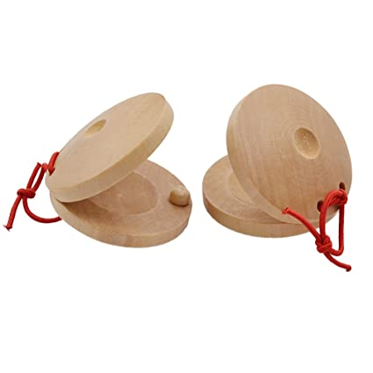
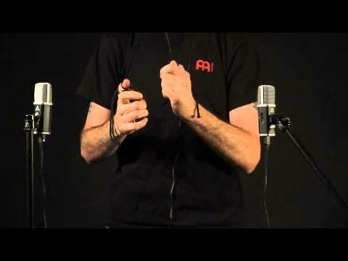
10. Castanets
Wooden shells attached together (with string)
Played in one hand, clacked together

Slide 22
That’s it!
You now know SO MANY different percussion instruments!
Please keep this slide for attribution.

